Slide 1
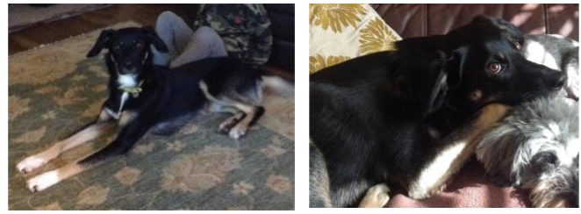
Welcome Gordon

Slide 2

Who is Gordon?
Gordan is a New Zealand Hunterway cross Collie Dog
He was born on the 18th December 2019
He has been chosen to come into school because of his good-natured, gentle temperament
Gordan has a lovely gentle nature
He loves long walks, playing and cuddles
Gordan’s main place of residence will be in the ALN office, which is secure and separate from the classrooms.
Over the coming weeks, Gordan will be visiting the school for short sessions each afternoon and will meet many of you very soon

Slide 3
Why do we need Gordon?
He can help us to read
He can help us to feel happy
He can teach me how to care for him
He can make me want to come in to school
He can make me smile
Can you think of any more reasons?

Slide 4
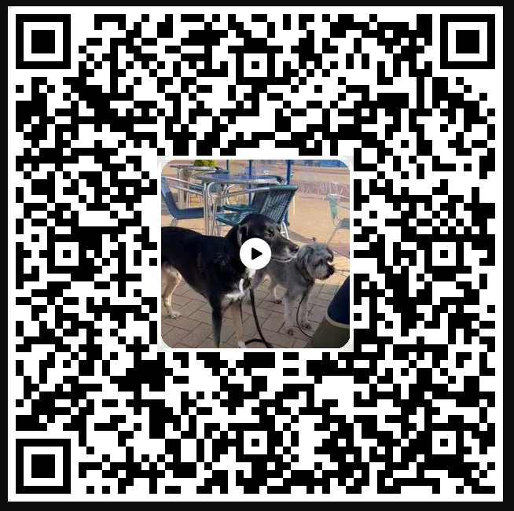
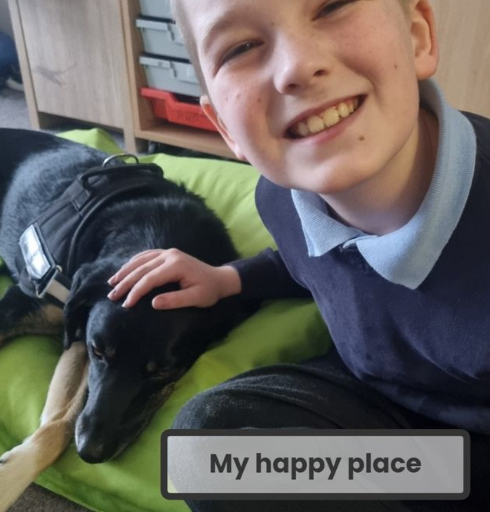
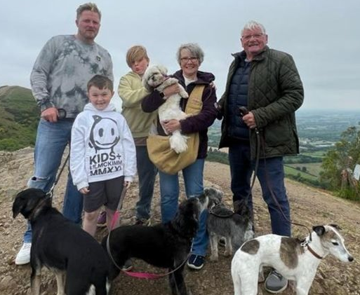
Gordon’s favourite hobby
Gordon in school
Gordon’s family

